Slide 1
Uncertainty quantification for regression models
Tripti Kumari
25 September 2020

Slide 2
Things I will cover
Prediction intervals
Analytical
Parametric
Non-parametric
Using quantile loss
Not covered
Details of confidence intervals
Bayesian approaches

Slide 3
Confidence intervals vs prediction intervals
Prediction & confidence intervals are often confused with each other. However, they are not quite the same thing
confidence interval measure the confidence in a given population statistic based on current sample e.g. mean , median, max, min
Prediction interval is where you expect your future values to fall given your observed data and model
Using confidence intervals for uncertainty in predictions will result in a much narrower range of values leading your intervals to not be calibrated properly as it completely ignores the random noise. A future measurement of y may be far away from our confidence interval because of the noise

Slide 4
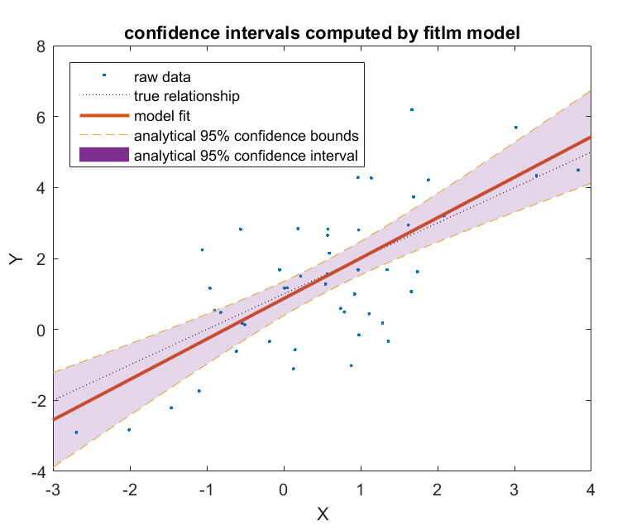

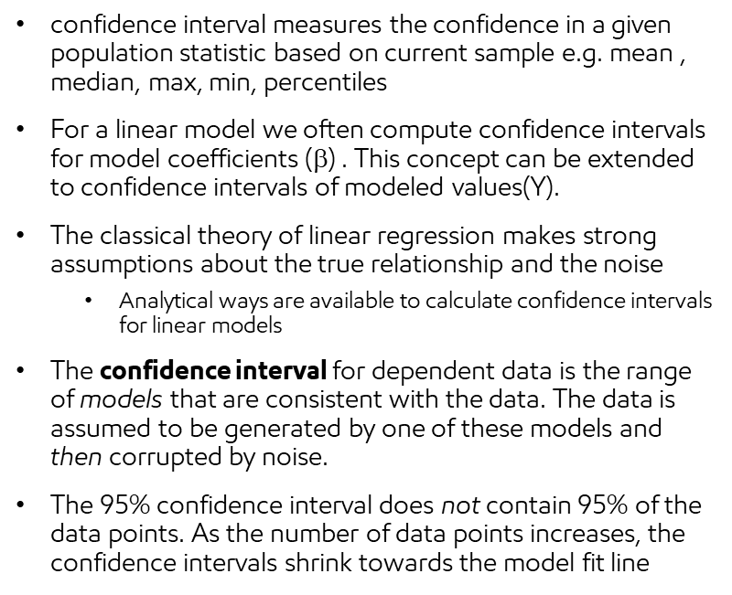

Analytical Confidence Interval
A general form of regression model is :
$$Y=f\left(X,β\right)+ ∈$$
confidence interval measures the confidence in a given population statistic based on current sample e.g. mean , median, max, min, percentiles
For a linear model we often compute confidence intervals for model coefficients ($$) . This concept can be extended to confidence intervals of modeled values(Y).
The classical theory of linear regression makes strong assumptions about the true relationship and the noise
Analytical ways are available to calculate confidence intervals for linear models
The confidence interval for dependent data is the range of models that are consistent with the data. The data is assumed to be generated by one of these models and then corrupted by noise.
The 95% confidence interval does not contain 95% of the data points. As the number of data points increases, the confidence intervals shrink towards the model fit line
Borrowed from Damian’s class on ML for geoscientists & engineers

Slide 5
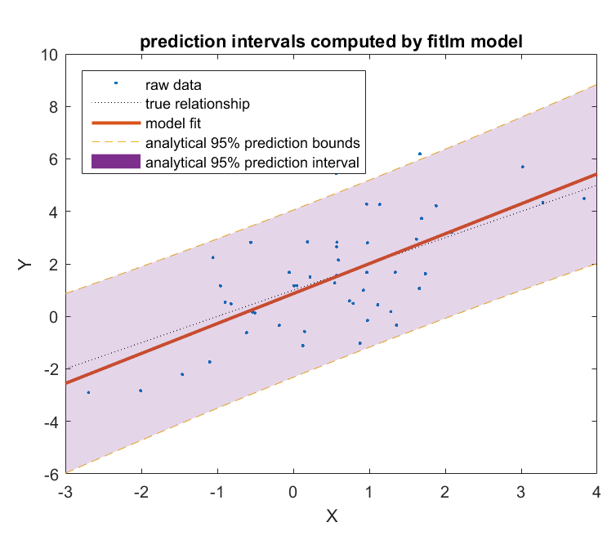





Analytical Prediction Interval
A general form of regression model is :
$$Y=f\left(X,β\right)+ ∈$$
The shape of the confidence intervals has been washed out by the data noise, which is uniform over all values of X.
In this example the only source of noise/error is the sample error
We can use analytical formulas to calculate prediction interval.
Only applicable for data generated by linear models
Error distribution is normal & iid
Sample estimate ± (t-multiplier × standard error)
Predicted value for a test sample when predictor is
T-multiplier with n-2 degrees of freedom
Borrowed from Damian’s class on ML for geoscientists & engineers
Unbiased estimate of noise
Number of samples
Prediction interval = confidence Interval of data + Confidence interval of noise
Notes:
Analytical method does not work for data generated by non-linear process such as a polynomial (e.g. quadratic)
iid – independent & identically distributed

Slide 6
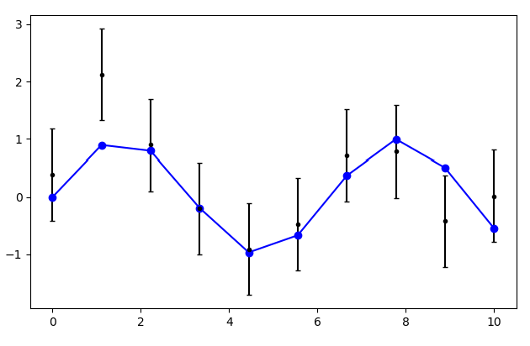





Defining Prediction intervals
Prediction Intervals are used to quantify uncertainty in regression models
range of values that would be reasonable estimates for noisy y data
Given the training data and trained model , the interval in which the true values of a new test sample will lie x percent of the time
90 percent prediction interval means the true values of the test data samples will lie in this interval 90 % of the time
True values
Predicted values
80% Prediction Interval
Y
X
$$Y=f\left(X\right)+ ∈$$
$$Prediction Error\left(x_{0}\right)={Bias}^{2}+Variance+Sample Error$$
$True Model$
$$\text{η}\left(x_{0}\right) + {\text{η}}_{n}\left(x_{0}\right) + ∈(x_{0})$$
$$f(X)=f\left(x_{0}\right)+\text{η}\left(x_{0}\right)+{\text{η}}_{n}\left(x_{0}\right)$$
$$Model estimate$$
Notes:
Sample error includes error x and y

Slide 7
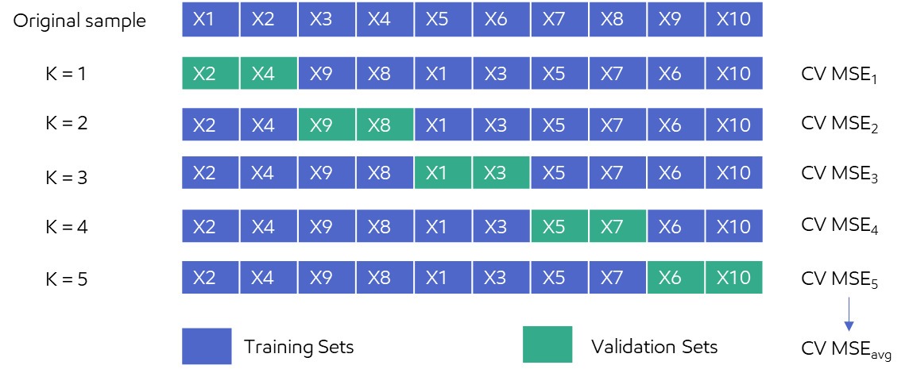

Model based uncertainty: (1) Distribution based
Parametric approach: assume a parametric form for error distribution (e.g., Gaussian)
Cross-validation error : estimate of generalization error when predictions are made on an independent test sample from the joint distribution of X & Y
New Sample
Prediction
Trained Model
X0
Y0
Assuming error distribution as Gaussian
P10 : Prediction(Y0) – 1.262 * RMSE (CV)
P90 : Prediction(Y0) + 1.262 * RMSE (CV)
Limitation: can lead to slightly bigger intervals
Constant width on both sides centered at the predicted value
Requires careful selection of cross-validation data for good calibration
Not good for situations when residuals have varying variance (e.g. heteroscedasticity)
Example of a 5 fold Cross validation technique
estimate of prediction error
RMSE (CV)
estimate of standard deviation of prediction error
$$\text{CV} \text{MSEavg}$$
Notes:
Learning

Slide 8
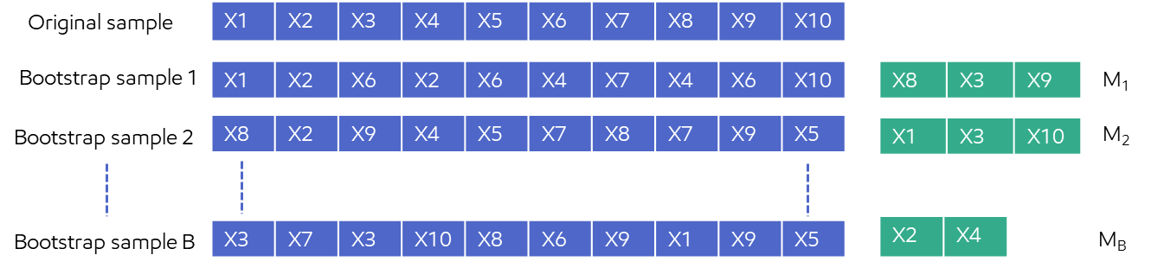
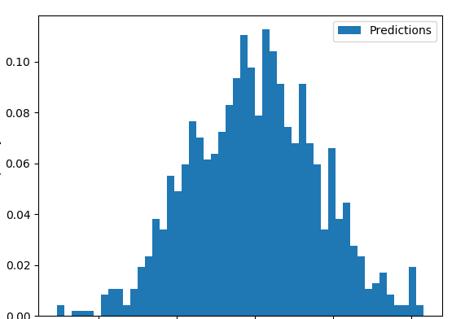
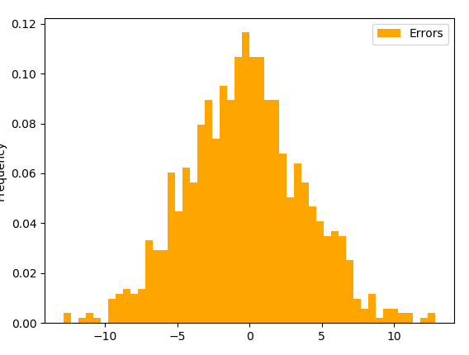
Model based uncertainty : (2 ) Non-Parametric
Non-parametric approach: No assumption regarding the sampling distribution of noise or data
Bootstrap (sampling with replacement) – B ~ 10,000
Can work with non-normal noise, non-linear data or if the model is overfitting
New Sample
Prediction
X0
Trained Model
Y0
Predict
Frequency
P10 : Y0 –P10 (error distribution)
P90 : Y0 + P90 (error distribution)
Training Sets
Test Sets
Models
Predictions
Example of a Bootstrap technique
Quantiles from combined error distribution
OOB Error
Ypred – avg(Ypred )
Computationally expensive as multiple models & multiple error distributions needed to be computed for each new sample
Other variants : using 0.632 + bootstrap estimate
Frequency
+
Frequency
Frequency
Errors
Errors
Errors
Bias + sample error
Variance error
Combined error
Notes:
0.632+ bootstrap estimate : uses no information error
It turns out that the training errors will usually be too small as we tend to overfit, so we have to rely on the validation errors somewhat.
validation errors will tend to be slightly too large however, as a bootstrap sample only contains roughly 2/3 of the training data on average, meaning that the predictions will be artificially worsened.
the distribution of the bootstrapped statistics approximates the distribution of the sample statistics.

Slide 9
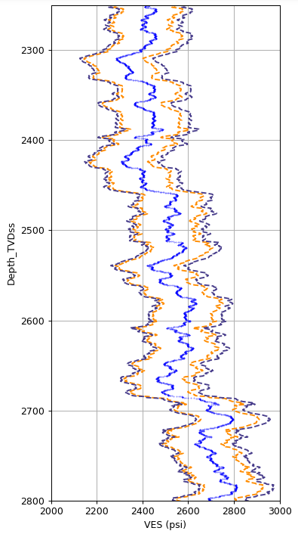
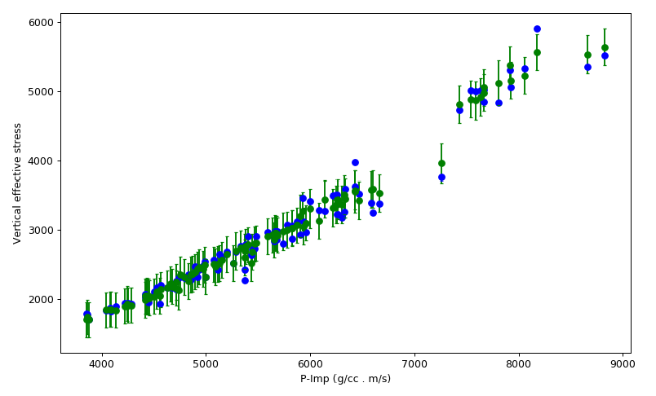
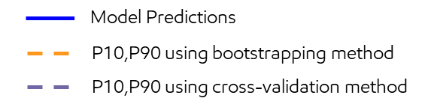
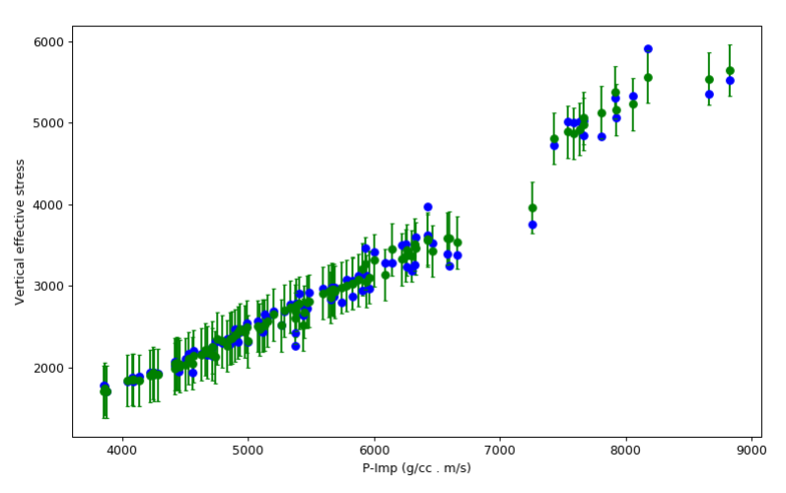
Parametric vs non-parametric uncertainty example
Parametric method
VES (psi)
True values
Predicted values
80% Prediction Interval
P - Imp (g/cc . m/s)
Test sample fraction within 80 % uncertainty interval ~ 0.82
Depth TVDss (m)
Bootstrap method
Parametric method
Constant width on both sides centered at the predicted value
Requires careful selection of cross-validation data for good calibration
Bootstrap method
Width of the interval can vary depending on error distribution
Robust method
VES (psi)
For this example from EG we are getting a fairly well calibrated interval from both methods
P - Imp (g/cc . m/s)
Test sample fraction within 80 % uncertainty interval ~ 0.80
Notes:
If error distribution is close to Gaussian, then even parametric approach works well
In this case , its hard to see but in case we have a skewed distribution, that will be observed in the bootstrapped method.

Slide 10
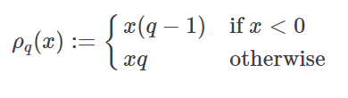
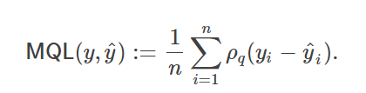
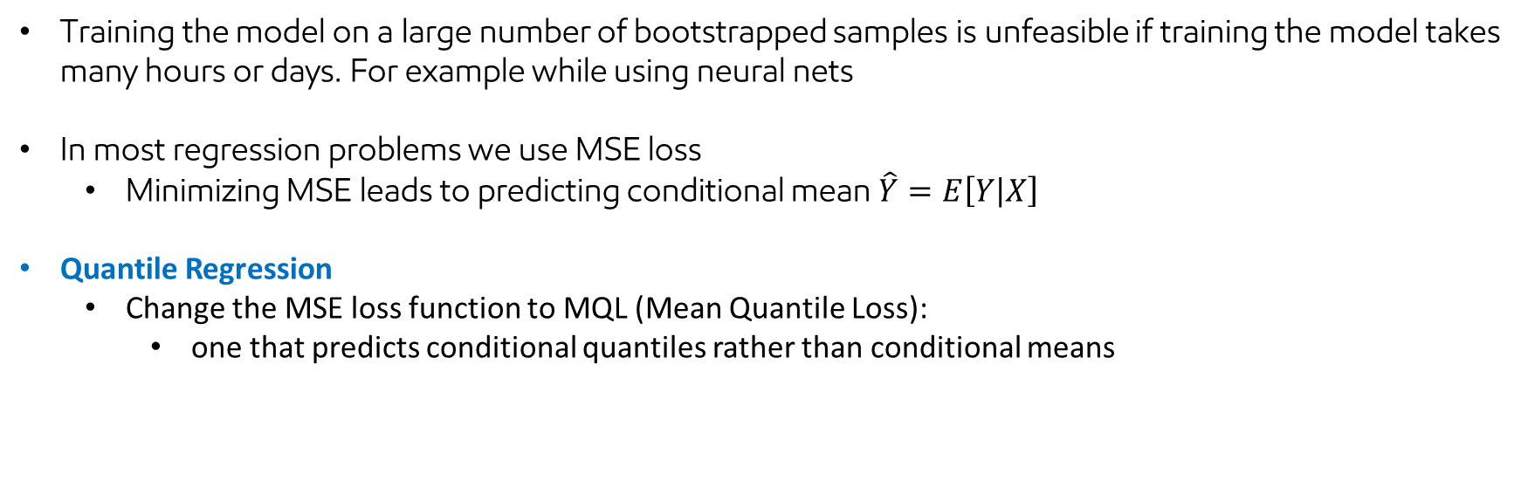

Quantile Regression
Training the model on a large number of bootstrapped samples is unfeasible if training the model takes many hours or days. For example while using neural nets
In most regression problems we use MSE loss
Minimizing MSE leads to predicting conditional mean$\hat{Y}=E\left[Y | X\right]$
Quantile Regression
Change the MSE loss function to MQL (Mean Quantile Loss):
one that predicts conditional quantiles rather than conditional means
Check function for q $∈$ (0,1)
Build 3 models : one each for high, low & mid case:
P10,P50,P90 -> q : [0.1, 0.5,0.9]
Limitations
The model is quantifying its own uncertainty : reliant on the model being able to correctly fit the data
if we’re overfitting the training data then the prediction intervals will also become over fitted

Slide 11
References
https://saattrupdan.github.io/2020-03-09-quantile-regression/
https://web.stanford.edu/~hastie/ElemStatLearn/ :
Chapter 7 (Model assessment & selection)
https://ntrs.nasa.gov/citations/20130014367
https://online.stat.psu.edu/stat501/lesson/3/3.3

